Slide 1

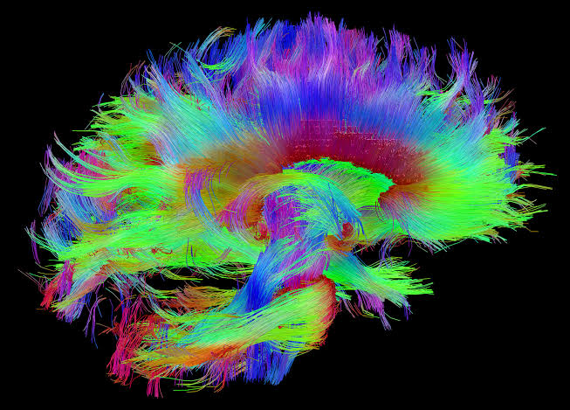
A 3D Printed Brain Computer Interface Neuroprosthesis
Samuel Parker
Completed Under the Supervision of
Dr Kaushik Mahata, Ph.D.

Slide 2
Notes:
The human brain is an immensely complicated entanglement of cells, each performing their own function to enable us to experience and interact with the world around us. Every thought you’ve had, the memories you’ve made throughout your life, every sensation you’ve felt, all your emotions, are all encoded as electrical signals. It is this passage of electricity that makes us human. For centuries, neuroscientists have been studying how the billions of cells in our brains interact in a global voyage of self discovery. Brain computer interfaces are a recent development that are built on the discoveries made in neuroscience. These devices have incredible potential to change the world, which I will discuss later, but for now, let’s take a closer look at how our brains work.

Slide 3
Na²⁺
K⁺
Notes:
The building block of our nervous system is the neuron. Your brain is made up of approximately 100 billion neurons! Neurons consist of dendritic branches, for listening to other neurons. These input signals are temporally integrated at the soma. Extending from the soma is the myelinated axon, which travels from the soma to the synaptic terminals, which connect to the dendrites of neighboring neurons. Neurons are surrounded by extracellular fluid and contain intracellular fluid. Each of these fluids contain different concentrations of ions, creating a concentration gradient across the cell membrane. At rest, the membrane potential is approximately -70mV. Excitatory neurotransmitter signals from other neurons arriving at the dendritic arbor temporarily opens ionic channels, slightly depolarizing the cell. In isolation, the passage of ions across the membrane will restore this slight positive change. However, when many signals occur in a short period, the cell will sufficiently depolarize to reach its threshold potential. Once this threshold potential is reached, a chain of events called an action potential occurs. Initially, voltage gated sodium channels open, allowing positive sodium ions to travel down their concentration gradient, into the cell. This generates a positive membrane potential. This positive membrane potential opens voltage gated potassium channels, which allows positive potassium ions to travel down their concentration gradient, out of the cell. The voltage gated sodium channels are now closed, so the efflux of potassium ions restores the neuron to its resting potential.

Slide 4
Notes:
By now, a voltage pulse has occurred, which conducts ionically down the axon and to the synaptic terminals, where it is passed to other neurons via the release of excitatory neurotransmitters.

Slide 5
Notes:
It is this repeated action potential that generates the spike trains that neurons use to communicate.

Slide 6
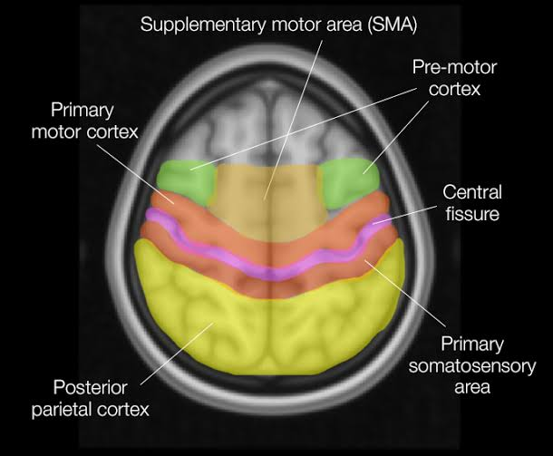
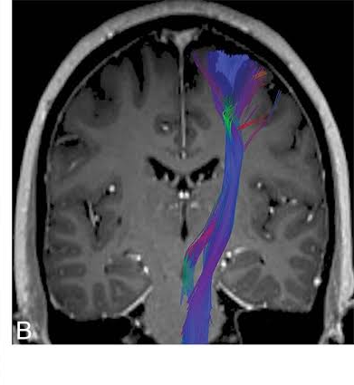
Notes:
The brain is systematically organized into regions of neurons with similar function. For example, these slides show the cortical regions responsible for voluntary skeletal movement, the pre-motor cortex, primary motor cortex and supplementary motor area. On the right you can see the corticospinal tract that makes up the internal capsule. This is the information superhighway connecting the motor cortical areas to the lower motor neurons in the spinal cord.

Slide 7
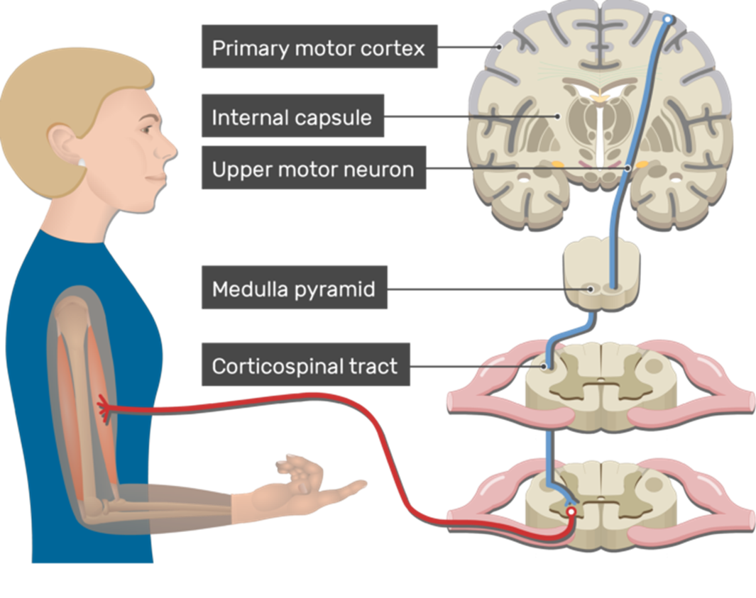
Breakdown in Signalling Path
Stroke
Spinal Cord Injury (SCI)
Degenerative Disease
Amputation
Notes:
This diagram shows the full signaling pathway of the corticospinal tract. The signals initiate in the Primary Motor Cortex, then descend through the internal capsule, which we examined on the previous slide. Then, at the level of the Medulla, the signals decussate, or cross over. So movements originating in the right hemisphere effect limbs on the left side, and vice versa. This is known as contralateral control. When the signal reaches the vertebrae level at which it exits, the upper motor neuron synapses onto a lower neuron, which is connected to the skeletal muscle. There are several cases where this neural signaling pathway may breakdown, including stroke, where the infarct region may include the internal capsule or medulla, a spinal cord injury, which severs the signaling pathway in the spinal cord, a degenerative disease which may cause a degradation at any point of the path, or amputation, where the signaling path remains intact until it reaches the lower motor neuron. Across the globe there are millions of people living with an upper limb disability, which limits their interactions and independence.

Slide 8
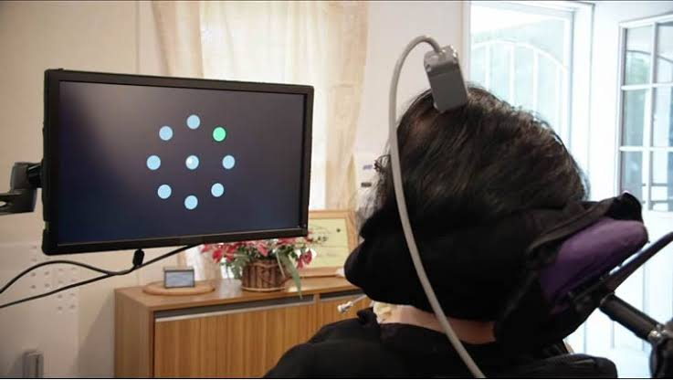
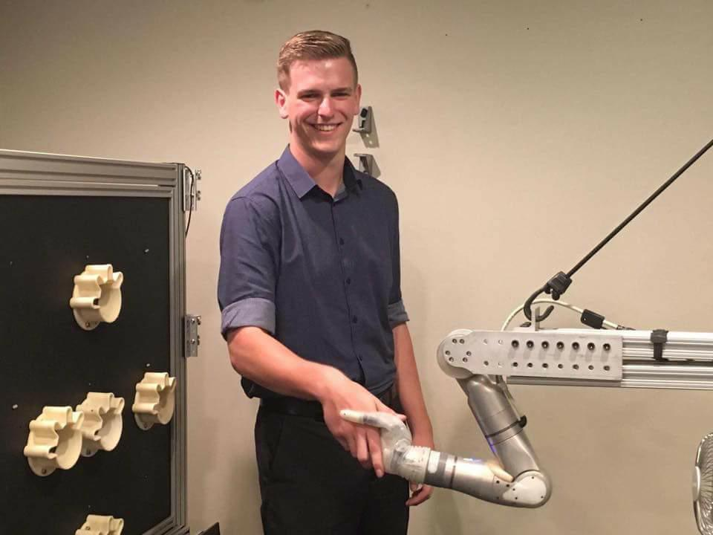
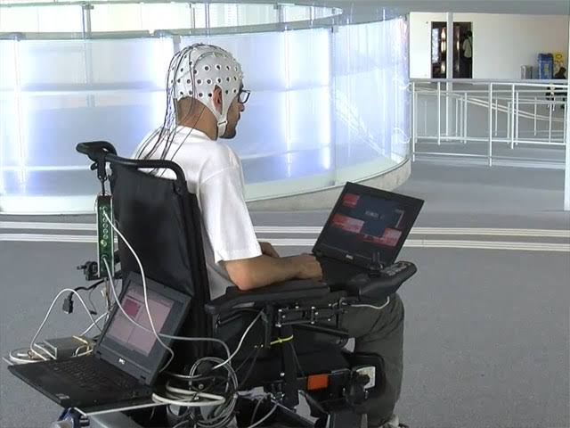
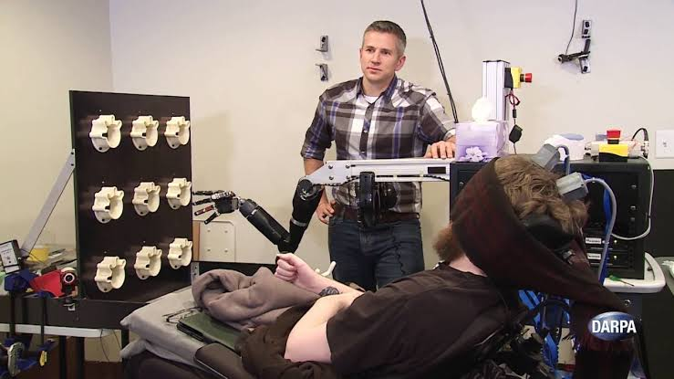
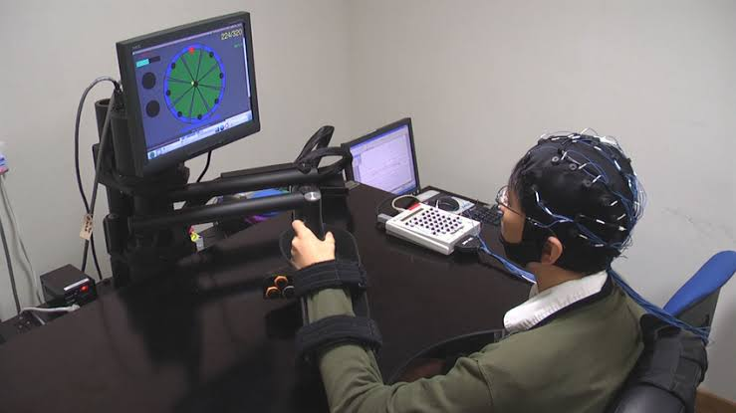
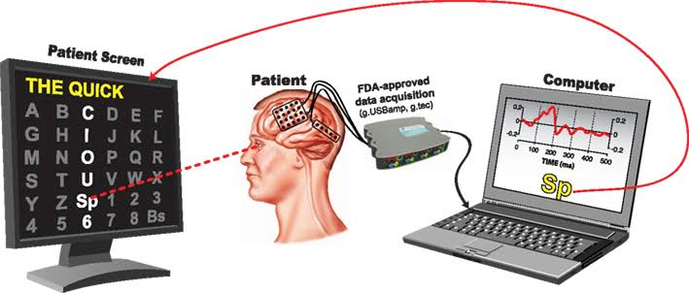

Recording
Processing
Effector
Feedback
Notes:
Research is currently being conducted to find a solution to these problems. One solution is Brain Computer Interface Devices. These are computers and systems that are controlled by the user’s neural activity. There are several examples of brain computer interface devices, including spelling systems, wheelchairs, devices to control computer cursors, and prosthetic devices. All these systems follow a similar functional structure. They require a method to record the neural activity, these methods include invasive and non-invasive approaches. They also need some means of processing the acquired signal, be that analog filtering, digital to analog conversion, and machine learning approaches, and then they need an end effector, which will serve as a source of feedback for the user. These devices have incredible potential to change the lives of so many people, restoring their ability to communicate and interact with their environment without assistance.

Slide 9
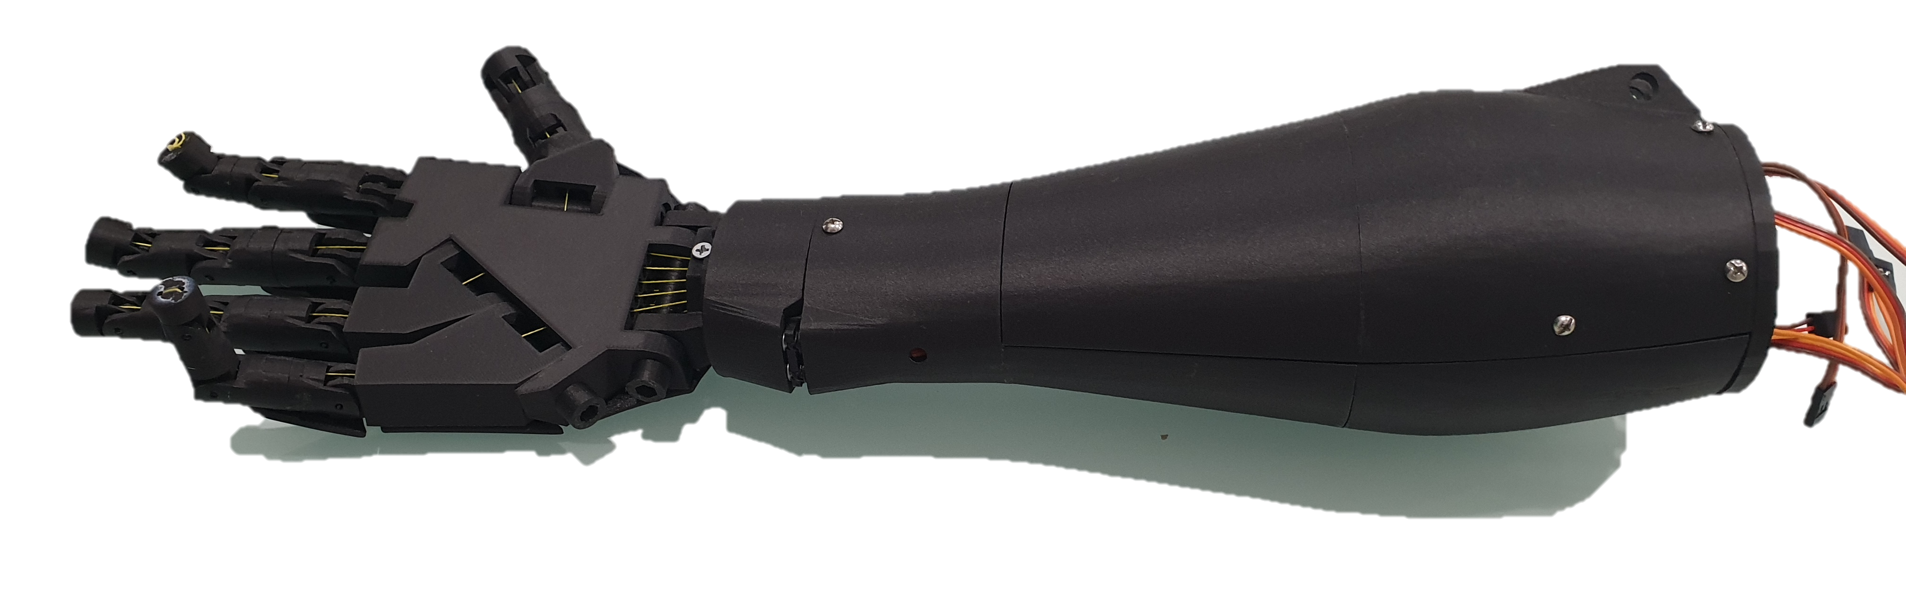
Notes:
My project will design and construct a rudimentary online Brain Computer Interface Prosthetic Hand. This involves designing a wireless electroencephalography data acquisition system, a real-time machine learning classifier, and constructing a carbon fibre 3D printed robotic arm. The outcome of the project will be neutrally controlled grasping, so the system must be able to differentiate between hand open and hand closed in real time. Real time classification mandates a robust classification feature extraction method. Additionally, many of the systems in published literature are prohibitively expensive, with many of the prosthetic devices costing in excess of $100,000, so this project aims to be an inexpensive solution. Finally, the data acquisition method has been constrained to only consider non-invasive methods. Additionally, the project aims to be a direct brain computer interface, rather than an indirect interface like electromyography which analyses the electrical signals generated by muscles when they flex.

Slide 10
Recording
Processing
Effector
Feedback
Notes:
The first step was to conduct a literature review to flesh out the details of this flow chart. What recording method should I use? How should the signal be processed? How would the end effector work?

Slide 11
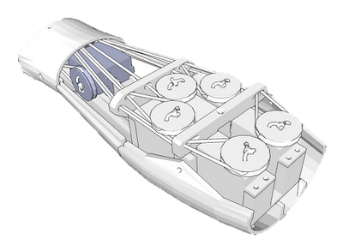
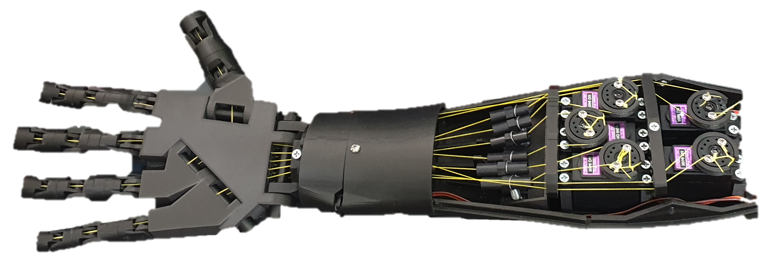
Notes:
I had initially identified the InMoov robotic hand as a viable solution. The arm forms part of an entire open source humanoid robot, and the STL files can be downloaded for free. Additionally, the design is elegant and aesthetically pleasing. Working with Philip Dombkins in the Uni workshop, we decided the arm could be printed using Onyx, which is a nylon filament with carbon fibre in suspension. This resulted in the arm being lightweight, and incredibly strong. The user will be able to see the state of the arm, which will serve as their feedback.

Slide 12
Recording
Processing
Effector
InMoov Arm
Open Source
Aesthetically Pleasing
Carbon Fibre & Nylon
Feedback
Notes:
This left details of the recording and signal processing systems to be determined.

Slide 13
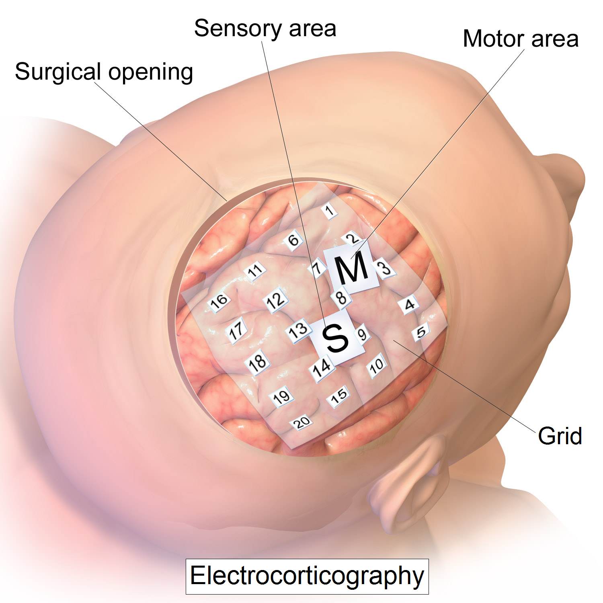
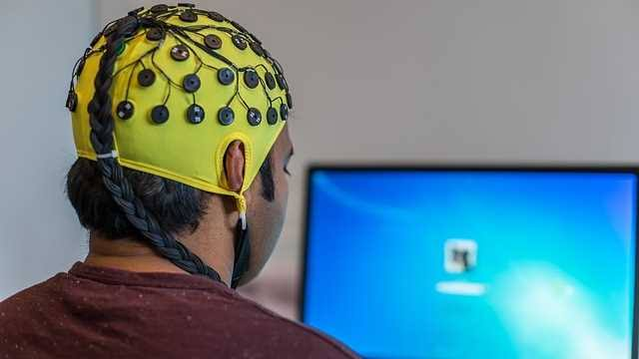
Notes:
The two main methods of signal recording in published brain computer interfaces are electrocorticography or ECoG, and electroencephalography, or EEG. ECoG provides a much higher signal to noise ratio, as the signal is not attenuated by the skull, however this is an invasive approach, so is out of the scope of this project. EEG, however, measures the cumulative effect of thousands of action potentials as they reach the scalp. It is a low cost, non-invasive approach. EEG has a low spatial resolution, since it detects the action of populations of neurons rather than individual neurons. However, it has a very high temporal resolution, with signals being recorded in real time, unlike alternative methods like fMRI.

Slide 14
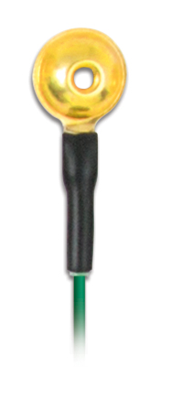
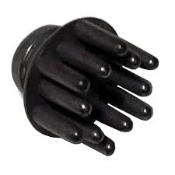
(a)
(b)
Notes:
Until recently, the state-of-the-art EEG electrode was the “wet” type gold cup electrode, shown on the left. These electrodes required extensive scalp preparation, and an electrically conductive gel to facilitate the measuring of scalp potentials. This would add additional time to the testing process. However, recent developments have resulted in “dry” type electrodes, which do not require any preparation, and work through hair. Therefore, it was determined that dry type electrodes would be preferable in the context of this project. These electrodes and the additional hardware to facilitate EEG recordings was purchased from Florida Research Instruments.

Slide 15
Recording
Processing
Effector
Feedback
EEG
Non-Invasive
High Temporal Resolution
Dry Electrodes
InMoov Arm
Open Source
Aesthetically Pleasing
Carbon Fibre & Nylon
Notes:
Finally, all the details of the signal processing were to be considered.

Slide 16
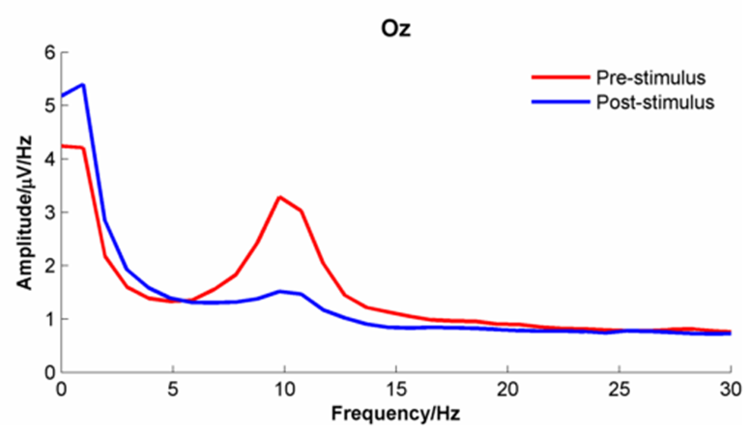
Notes:
When designing signal processing elements, it is useful to consider what we are looking for. Neurons encode their information in their firing rate. The firing rate is represented by the frequency of the EEG waveform. Here is an example of a study conducted by Burgess, which shows the changes in the frequency content of the EEG signal over the occipital lobe (which processes visual information) before and after the subject views a familiar face. The same observations have been observed during the execution of a motor intention. Therefore, to classify between motor intention and rest, we must examine the frequency content of the EEG signal.

Slide 17
x
x
x
Adaptive Autoregressive Modelling
x
x
x
x
Discrete Wavelet Transform
Short Time Fourier Transform
Notes:
There are several methods of generating frequency information about a waveform. Firstly, Autoregressive Modelling examines the previous n-samples to try to predict the next sample by using the Least Squares method to identify the filter coefficients. The poles of the filter can be used as the feature vector in this case. The second approach is the discrete wavelet transform. This transform decomposes the EEG signal into a weight sum of wavelets, of varying frequency and period. Therefore the feature vector would include time-frequency values, which is beneficial for an online BCI system, as information regarding the frequency of the EEG signal at a certain time can be determined. It also provides a high resolution in the low frequency spectrum of the signal. The most common form of feature extraction for BCI systems is the Short Time Fourier Transform. This transform slides a window over the EEG signal, and calculates the DFT of the signal in the window, again producing time-frequency information. The FFT is a computationally efficient algorithm, which can lead to faster classification times. However, if good spectral resolution is required, the feature vector can be increasingly long, which is not beneficial for machine learning classifiers that suffer harshly from dimensionality issues.

Slide 18

Discrete Cosine Transform
0 Hz
1 Hz
2 Hz
3 Hz
4 Hz
5 Hz
6 Hz
7 Hz
Notes:
During the semester, Kaushik identified an additional feature extraction method to examine, the Discrete Cosine Transform. This transform is commonly used in JPEG image compression, but has not yet been applied to Brain Computer Interfaces. Here’s how it works: Let’s first consider an 8 sample long signal with frequency 0. This is just DC. Now consider a signal, also 8 sample long, that contains a cosine function with a 1Hz frequency. Now 2 Hz. Now 3. If I repeat the process up to 7 Hz, I can represent any 8 sample signal using a weight sum of these 8 cosine functions. Therefore, the first step of the discrete cosine transform is to create a vector, in this case it is 8 values long, which contains the weighting coefficients for each of the 8 cosine waves above.

Slide 19
Discrete Cosine Transform
0 Hz
1 Hz
2 Hz
3 Hz
4 Hz
5 Hz
6 Hz
7 Hz
10.4
5.6
12.4
18.3
14.2
21.9
11.6
9.2
Weighting Coefficients
Notes:
This is an example of this first step, a hypothetical signal has been decomposed into the sum of 8 cosine functions, with weighting coefficients provided in the vector.

Slide 20
Discrete Cosine Transform
10.4
5.6
12.4
18.3
14.2
21.9
11.6
9.2
Weighting Coefficients
60
55
42
37
20
0.5
0
0
Quantisation Coefficients
Notes:
So far this has been very similar to the DFT. However, the DCT provides some “lossy” compression, in the form of a quantisation vector. This is a vector of numbers, determined such that the product of the quantisation vector and the weighting coefficients still produces a signal with 90% of the power of the original signal. This means that the high frequency components can be reduced to 0, or “compressed” by assigning a quantisation coefficient of 0. Multiplying the weighting coefficients by the quantisation coefficients gives the DCT coefficients of the signal.

Slide 21
624
308
520.8
677.1
284
10.95
0
0
DCT Coefficients
Compressed Data: Represent 8 samples using 6 coefficients
Lossy Compression
Compression mostly affects high frequencies. EEG data < 30 Hz, so not strongly affected with appropriate window size
Reduce classification space dimensionality
Notes:
You can see that the 8 sample signal can now be represented by 6 coefficients, and has been compressed. This lossy compression reduces the impact of high frequencies in the signal. Since any high frequency components in an EEG signal is noise, this does not affect the integrity of the EEG data. Therefore, by compressing the feature vector, the classification dimensionality is reduced, which reduces classification time.

Slide 22




Linear Discriminant Analysis
Quadratic Discriminant Analysis
Support Vector Machine
k-Nearest Neighbours
Notes:
Once the feature vector had been determined by one of the 4 methods previously discussed, the observation needs to be classified by a machine learning algorithm. In published literature, the machine learning approaches used have been Linear Discriminant Analysis, Quadratic Discriminant Analysis, Support Vector Machines, and k-Nearest Neighbours. These classifiers have received varying levels of success. Part of the challenge of comparing these approaches by just reading the literature is each classification paradigm and data acquisition system is different. The performance of the classifier is affected by the performance of the feature extraction method. Therefore, to accurately compare these classification methods, I have conducted a comparative analysis using the same EEG dataset. Features will be extracted from the dataset using the SFTF and the DCT, so the performance of these feature extraction techniques can be compared.

Slide 23
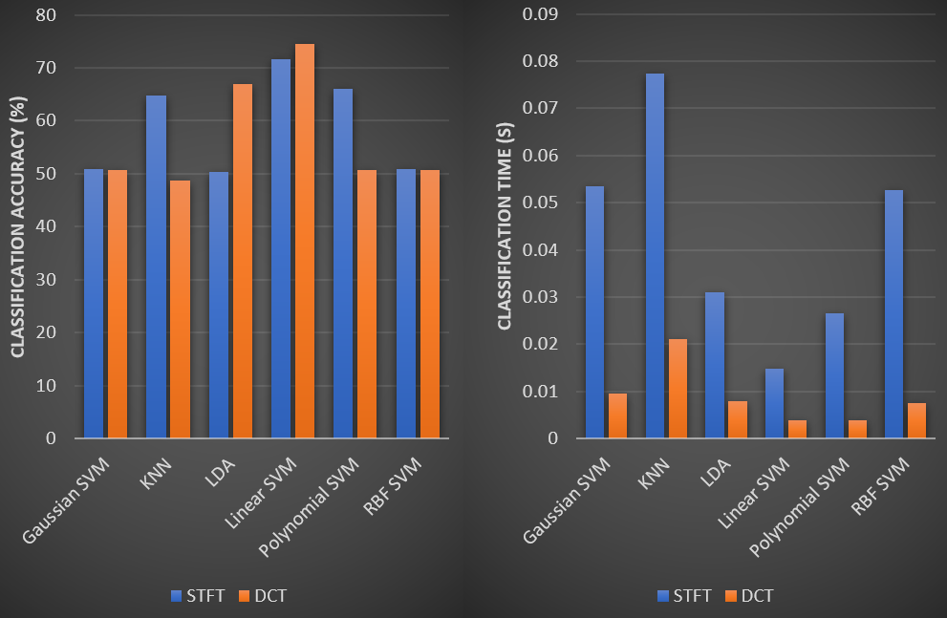
Notes:
These are the results of the analysis. It shows that the Linear SVM achieves the greatest classification accuracy for both feature extraction methods. What is more interesting, however, is that classification accuracy remained mostly the same between feature extraction methods. Classification time, however, fell drastically when moving from STFT to DCT. This is a reflection of the reduced feature space dimensionality. This has tremendous impact on online BCIs, where classification time is of particular importance. As previously mentioned, the DCT has not been applied in a BCI system, yet these results prove it be extremely beneficial.

Slide 24
Recording
Processing
Effector
Feedback
EEG
Non-Invasive
High Temporal Resolution
Dry Electrodes
DCT Feature Extraction
Reduced Dimensionality
Linear SVM
Computationally simple
InMoov Arm
Open Source
Aesthetically Pleasing
Carbon Fibre & Nylon
Notes:
This completed the puzzle, and all elements of the system were known.

Slide 25

Data Acquisition Board
ADS1299
ATmega328P
EEG Hardware
Bluetooth Module
SPI
UART
Analog Signals
Bluetooth
STM32F407
Prosthetic Hand
Bluetooth Module
UART
PWM
Classification and Control Board
Notes:
The system proposed will be implemented using the following hardware. The EEG signals acquired by the EEG headset will be digitized using an AS1299 EEG front end ADC chip. This chip features 24 bit resolution, and can sample data between 250 and 16k samples per second. The data will be retrieved over an SPI interface by an ATmega328P, which will then send the data wirelessly to the classification and control board. The classification and control board, where an STM32 chip will classify the data. Once the chip has classified the data, it will generate PWM control signals which will be passed to the servos in the prosthetic hand.

Slide 26
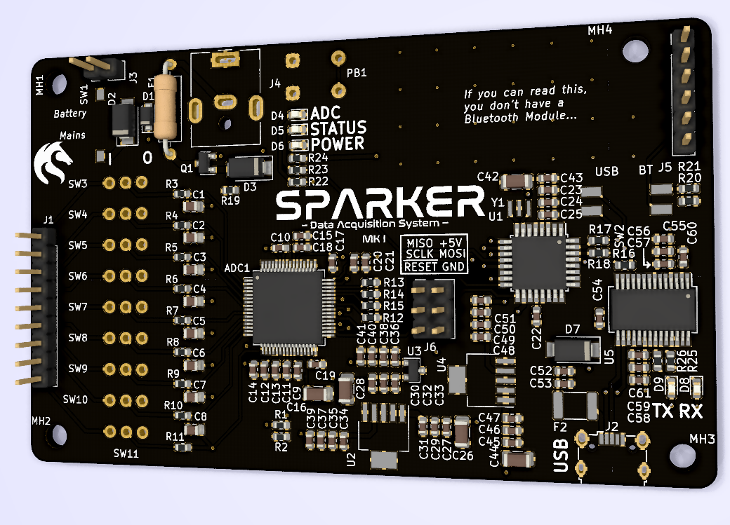
Notes:
This is a render of the data acquisition board. I am currently completing a final round of reviews of the board, but am looking forward to receiving it soon.

Slide 27
ATmega328P
Serial Library
Bluetooth Hardware
UART
Direct
Main Function
Direct
ADS1299 Module
Direct
ADS1299
SPI Hardware
SPI Library
SPI Bus
Notes:
This is an architecture diagram for the software on the data acquisition board. The main function will interact with the ADS1299 through an ADS1299 module, which will hold the specific functions for interacting with the ADC. It will then simply pass the information to the Bluetooth hardware.

Slide 28
STM32F407VET6TR
SVM Library
Serial Library
Bluetooth Hardware
UART
Direct
Direct
Main Function
Classification Module
Direct
Direct
Direct
Control Module
Feature Extraction Module
Direct
Direct
Prosthetic Hand
PWM Hardware
DCT Library
PWM
Notes:
This is the software architecture module for the classification and control board. The board will read the data from the Bluetooth module. It will then pass it to the feature extraction module, which will use the DCT library to generate the feature vector. The feature vector will then be passed to the classification module, which will have been trained using a large dataset of published EEG data. If it is found that the recording paradigm used to generate the dataset is too different to the methods used in this project, resulting in the classifier not being appropriately trained, I will generate my own training data. Once the classification module determines the state of the user’s hand, open or closed, it will pass this to the control module, which will generate the PWM control signals to be passed to the servos in the prosthetic hand. Once all these modules are working in unison, the project will be completed, and the first BCI prosthetic hand to use the DCT will have been created.

Slide 29
Dec Jan Feb Mar Apr May Jun
DAQ
Classification
System Integration
Scope Expansion?
Documentation
Notes:
This is an overview of my plan for completion. The data acquisition board will be manufactured soon, and during that time I will be designing the classification and control board. Once the designs have been finished, I will submit the designs for fabrication and procure all the necessary components. Then I can start testing the classification board, initially by providing known good data, then data acquired using the system. Once the classification board has been tested sufficiently, I will integrate all the components into the finished system, the commence systemwide testing. This will complete the objectives of the report. If I complete this with extra time, I will consider expanding the scope to potentially consider spatial filtering, or other improvements. I will be continually updating the documentation as I progress.

Slide 30
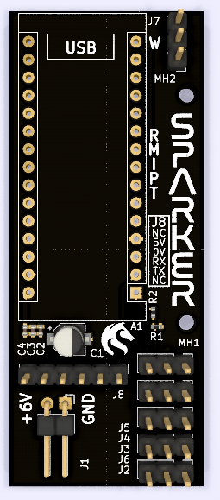
Thank you!
Demo and Q&A

Slide 31
Quick Select
Title Slide
Connectome
Neurons
Corticospinal Tract
BCIs
Arm Closed (Scope)
BCI Overview
End Effector
Recording Methods
Signal Processing
Feature Extraction
DCT
Classification
Comparison
System Overview
Data Acquisition Board
Data Acquisition Software
Classification and Control Software
Gantt Chart
Backup – STFT Heatmap
Backup – Data Acquisition Schematic

Slide 32
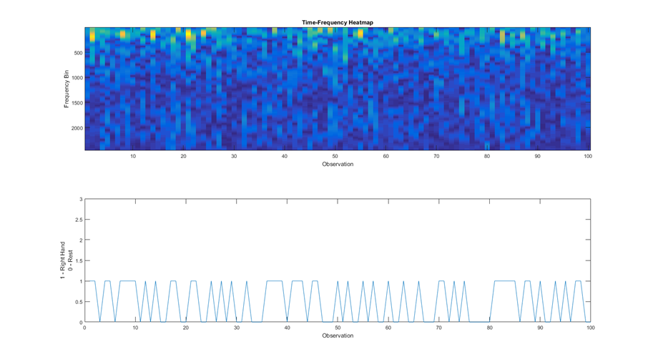
Dataset Visualisation

Slide 33
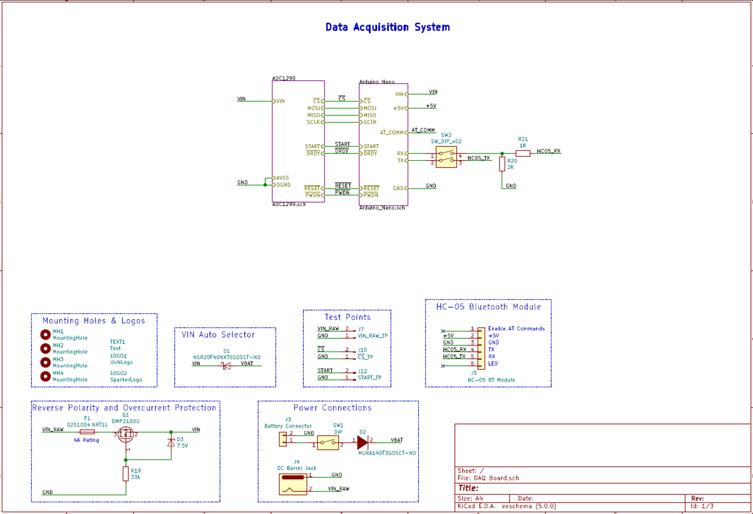
DAQ Board Schematic

Slide 34
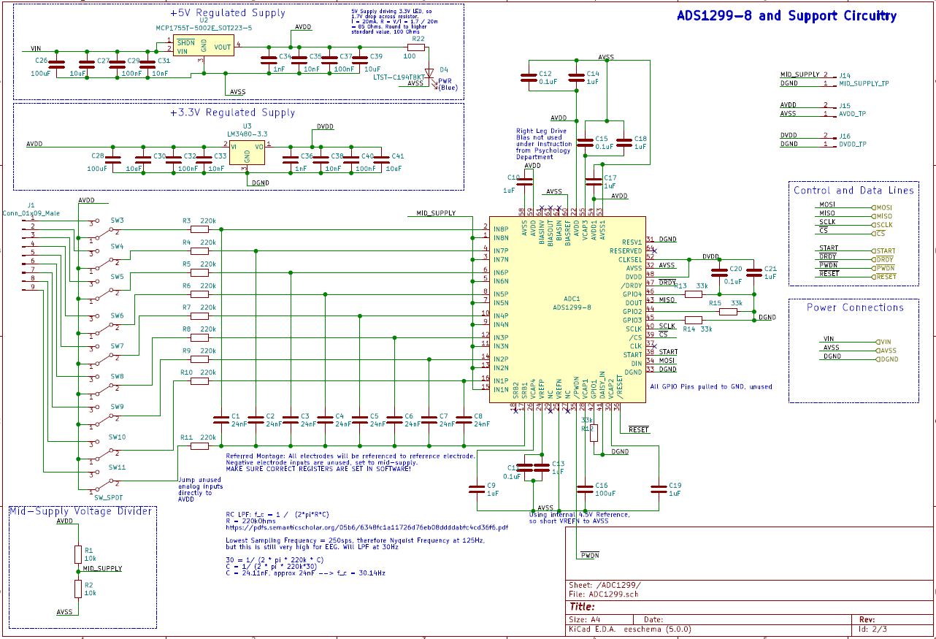
DAQ Board Schematic

Slide 35
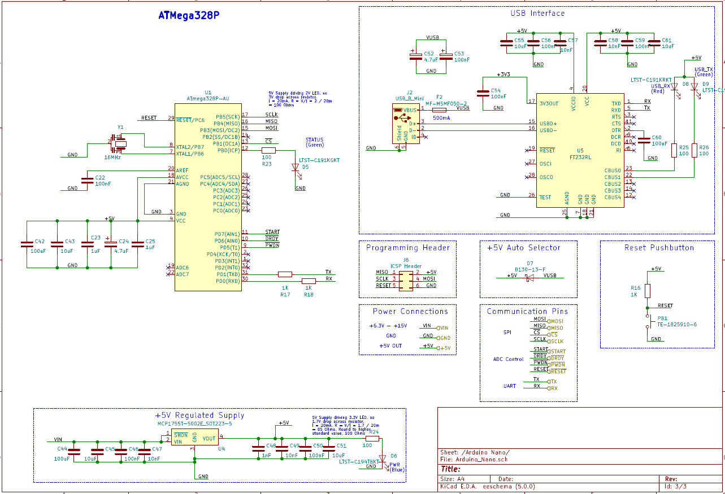
DAQ Board Schematic

